Slide 1
NEO4J CYPHER TUTORIAL WITH PYTHON
Export JSON Data From Neo4j Graph Using Apoc
Tutorial 80

Slide 2
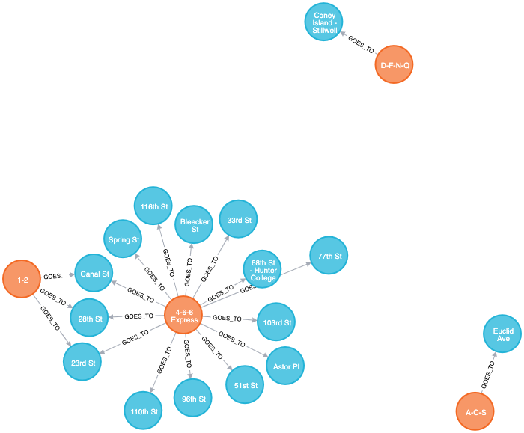
Sample Graph For NEW YORK METRO

Slide 3
Use case
Generate json file from neo4j graph using apoc procedures

Slide 4
Pre-requisites
apoc.import.file.use_neo4j_config=false
apoc.export.file.enabled=true

Slide 5
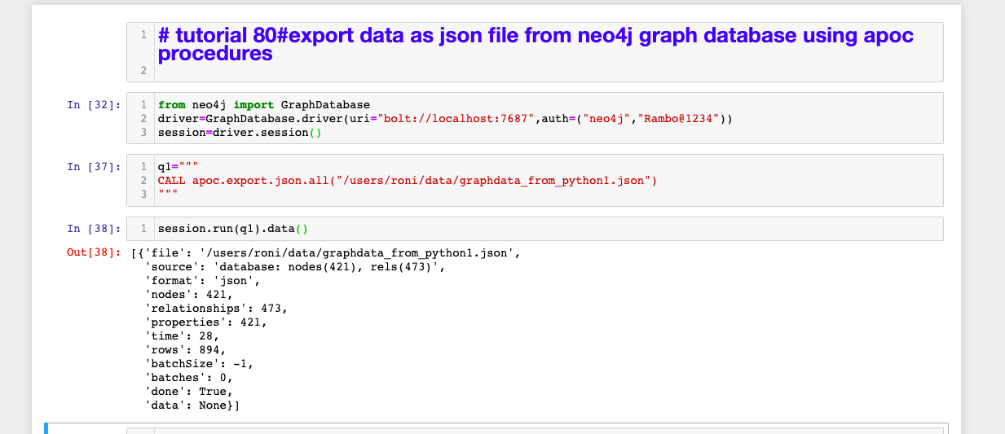
code
Use case

